Slide 1




Critical Thinking S1 2023
Tutor: Dr. Iwan Williams
Email: iwan.williams1@monash.edu

Slide 2
Lecture 5.1.
Truth and confidence

Slide 3
Review pop quiz!

Slide 4
Two features of a good/successful argument:
All the premises are acceptable as true.
The premises support the conclusion.
How might we find out whether a premise is true?
Under what conditions should we accept a premise as true?
Notes:
Already had some practice at this in your AT1. We’re going

Slide 5
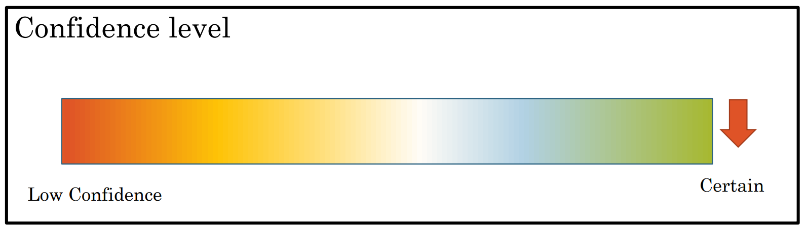
Truth and evidence
Sources of evidence when evaluating premises:
Could you easily check whether the premise is true by looking it up in a reference book or other reliable source?
Is the premise beyond reasonable doubt? Is it common knowledge?
Does the premise contradict something else you know to be true for good reasons?
If the premise offers an explanation of something, are there any plausible alternative explanations?
Does the premise come from an expert source or a reliable authority?
If the premise is a generalisation, can you think of any counter-examples?
Truth is binary: statements are either true or they are false.
Squares have four sides
The population of Australia is greater than 267 million.
Koalas are lizards.
Computers don’t feel pain.
But judgements of truth (beliefs) aren’t binary …
Our evidence (reasons) for believing that a statement is true comes in degrees.
Thus, we can have varying degrees of confidence in our beliefs.
Notes:
This is an oversimplification. A couple of caveats:
Meaningless sentences might be neither true or false.
And some sentences can be interpreted in multiple ways.
But if a sentence is meaningful, and we can we fix on an interpretation, then it’s either true or false.
Some other tricky cases (some things are indeterminate) and some philosophers reject this view, but let’s roll with it for now

Slide 6
“Squares have four sides”
Analytic statement: true by definition

Slide 7
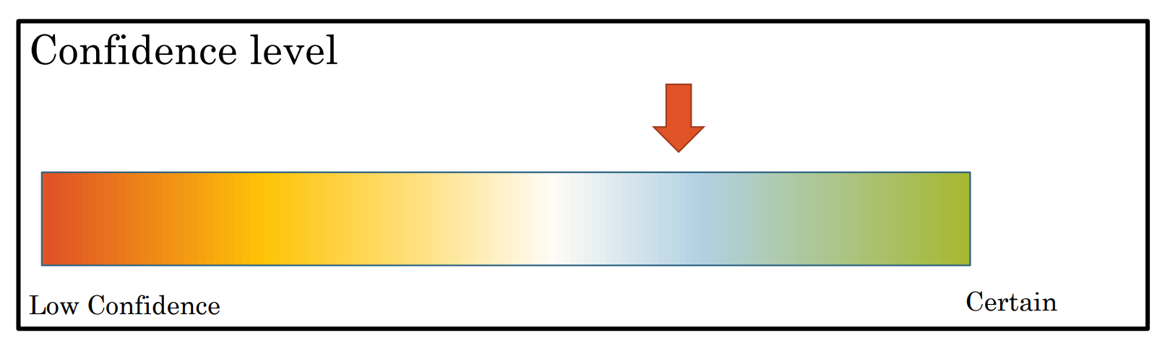
“The population of Australia is > 27 million”
Empirical statement: depends on how the world is, not just the meanings of the words
T
Iwan’s initial judgement:

Slide 8
“The population of Australia is > 27 million”
Empirical statement: depends on how the world is, not just the meanings of the words
Confidence is determined by the strength of evidence.
The greater my degree of confidence (i.e. the stronger the evidence), the more inclined I should be to accept it as true.
Notes:
This is not just guessing, because my degree of belief is determined by the strength of the evidence
That means, my degree of belief should by sensitive to any new evidence

Slide 9
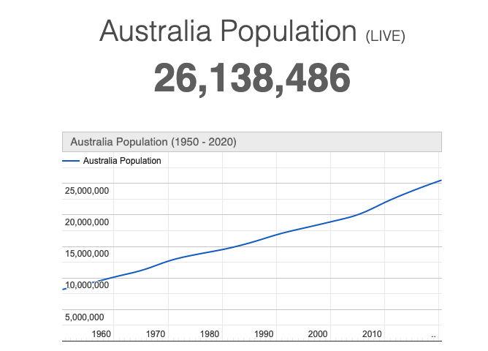
“The population of Australia is > 27 million”
New evidence (reasons) should lead me to update my belief!
T
F
Iwan’s updated judgement:
Notes:
- I’m still not certain – typo/glitch in the website, imperfect statistics etc.
Take homes:
- We should revise our beliefs as we encounter new evidence
- Our confidence in whether a statement is true or false should be proportional to the strength of our evidence

Slide 10
Lecture 5.2
Appeals to authority

Slide 11
Appeals to Authority
An appeal to authority is when a particular source says that a statement is true, and we take that as evidence that that statement is true.
Two kinds of authorities people might appeal to:
Experts
Witnesses
Is appealing to authority good or bad?
It depends!
We need to distinguish legitimate and illegitimate appeals to authority.
Notes:
Some people assume that appeals to authority are always bad.
We are often admonished to “think independently” (wake up sheeple).
If this means carefully evaluating people’s arguments and assessing the reliability of sources, then absolutely!
But if this means never relying on the expertise or testimony of others then this is IMPOSSIBLE and more importantly UNNECESSARY.

Slide 12
Appeals to Authority
Three things should you consider when evaluating an appeal to authority
Is the source in a position to know?
Are they reliable: Do they have a motive to lie? Do they have a history of unreliability?
Is there any corroborating evidence?

Slide 13
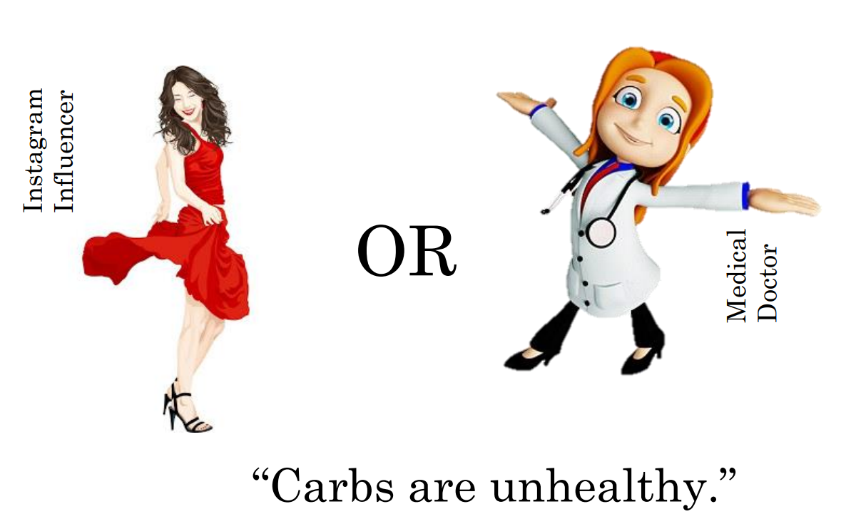
Who’s the expert?

Slide 14
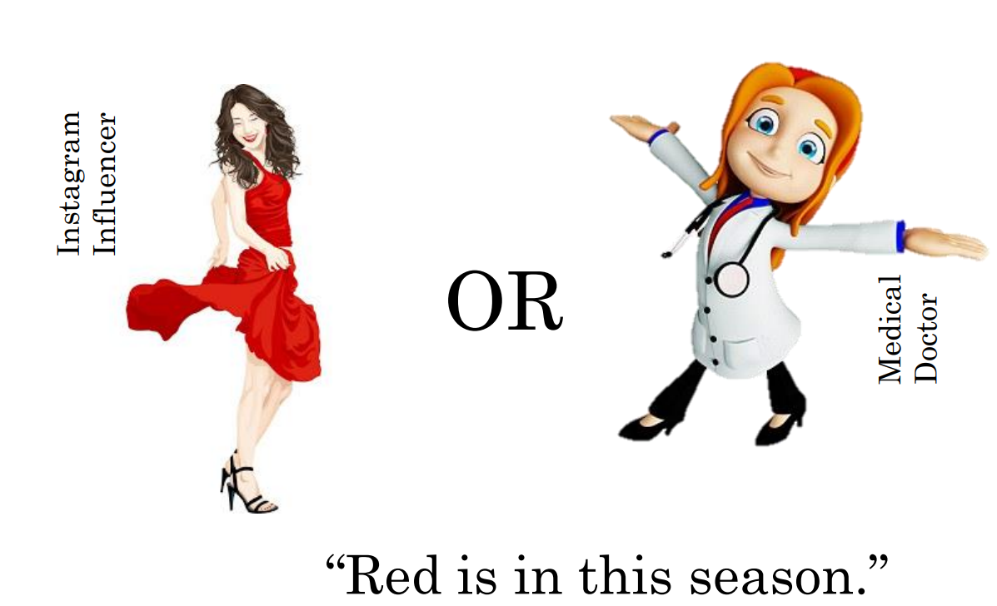
Who’s the expert?

Slide 15
Experts
An expert is trained in or has expertise in a certain domain of knowledge or skill.
Questions on climate change should be asked to climate scientists, not politicians
Questions on plumbing should be asked to plumbers, not carpenters
No one is an expert full-stop (i.e. an expert in everything)!
The important question when someone appeals to a supposed expert as an authority on a claim: is this person an expert in the relevant domain?
(i.e. are they in a position to know about this matter?)

Slide 16


Who is the best expert?
“Volkswagens don’t emit much nitric oxide”
Notes:
- EPA found that Volkswagen had intentionally programmed the engines in certain cars to activate their emissions controls only during laboratory emissions testing, which caused the vehicles' NOx output to meet US standards during regulatory testing. However, the vehicles emitted up to 40 times more NOx in real-world driving

Slide 17
Important questions - reliability
Is there any reason to suspect the reliability of the source?
What is the source’s reputation for reliability?
Does the source have a motive for not telling the truth?

Slide 18
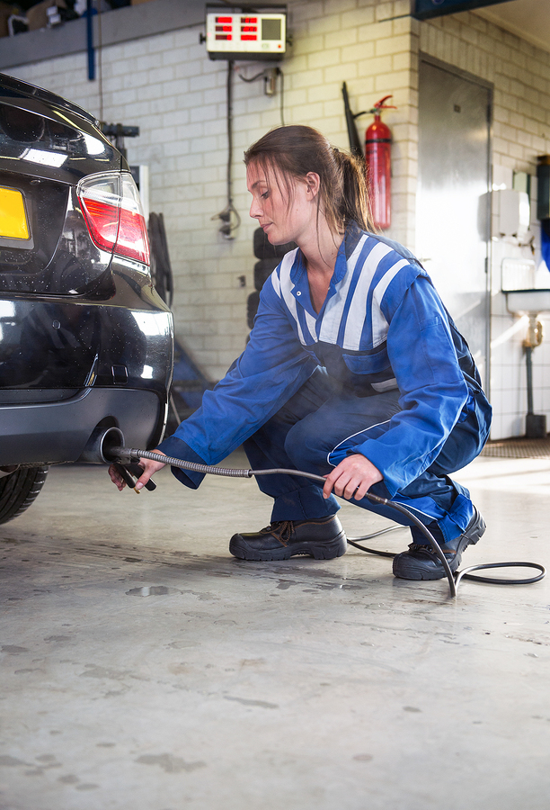



Corroborating evidence
“Volkswagens don’t emit much nitric oxide”
“Volkswagens don’t emit much nitric oxide”
Not an independent source!
corroborating evidence

Slide 19
Appeals to Authority
Three things should you consider when evaluating an appeal to authority
Is the source in a position to know?
Are they reliable: Do they have a motive to lie? Do they have a history of unreliability?
Is there any corroborating evidence?

Slide 20
Ad hominem
We should evaluate sources when the source’s credibility is the only reason given for accepting the claim.
When should we NOT respond to a claim by evaluating the source?
When the source has provided an argument for the claim.
Politician 1: As a country, we’re not spending enough on education. The statistics show that our children are falling behind compared to similar developed nations.
Politician 2: Politician 1’s views on education are totally irrelevant and wrong! After all, this is someone who was born with a silver spoon in their mouth and never attended a public school a day in their life!
Politician 2 is committing a fallacy called ad hominem. They are evaluating the source (Politician 1) but not engaging with their argument.

Slide 21
Lecture 5.3
Generalisations

Slide 22
Two kinds of generalisation
Universal Generalization: a claim that says something about all things of a certain kind
All metals conduct electricity.
The government should ban all cigarette advertising.
Everyone in my class has seen Frozen 2.
Killing is never justified.
No one can travel internationally without special permission.
The only flightless birds are penguins.
“all”, “every”, “anyone”, “everyone”, “whenever”, “never”, “no-one”

Slide 23
Two kinds of generalisation
Statistical Generalization: a claim that says something about some number of things of a certain kind
90% of nurses are women.
Most of the people killed in wars are civilians, not soldiers.
In some parts of the country, youth unemployment is at 25%.
Only a minority of voters now support the president.
Many of my friends have experienced racism.
“some”, “many”, “25%”, “a minority”, “most”

Slide 24
Translating Universal Generalisations
Universal generalisations don’t always contain the term “all”
But when putting them in generalised form, you should turn them into an “All __ are __” sentence.
→
A = dogs
B = mammals
“Dogs are mammals”
(= All dogs are mammals)
“Diamonds are not cheap”
(= All diamonds are not cheap)
(= No diamonds are cheap)
All A are B
All A are not B
→
A = diamonds
B = cheap things

Slide 25
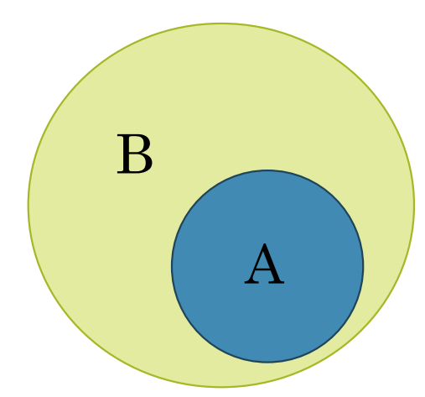
Diagrams for universal generalisations
All A are B
All metals conduct electricity.
A = metals
B = things that conduct electricity

Slide 26
Diagrams for universal generalisations
All A are B
Only celebrities are invited to my party
A = people invited to my party
B = celebrities

Slide 27
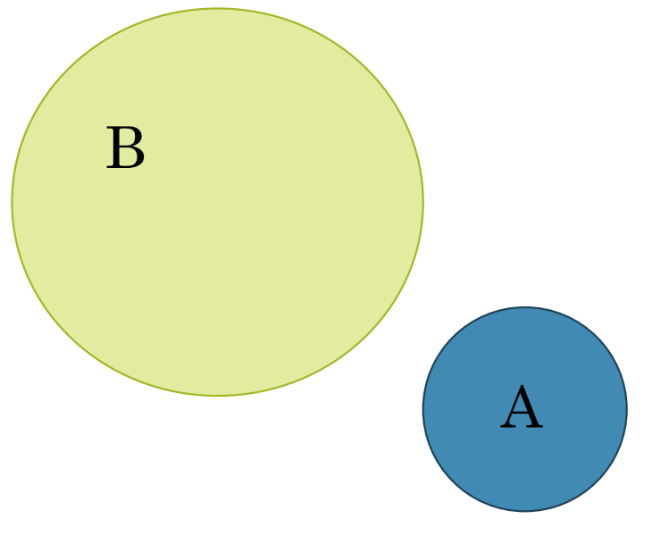
Diagrams for universal generalisations
All A are not B
(No A are B)
Killing is never justified
All A are not B
A = killings
B = acts that are justified

Slide 28
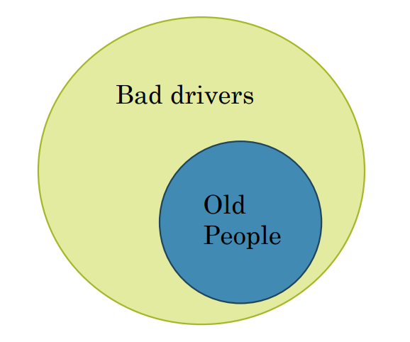
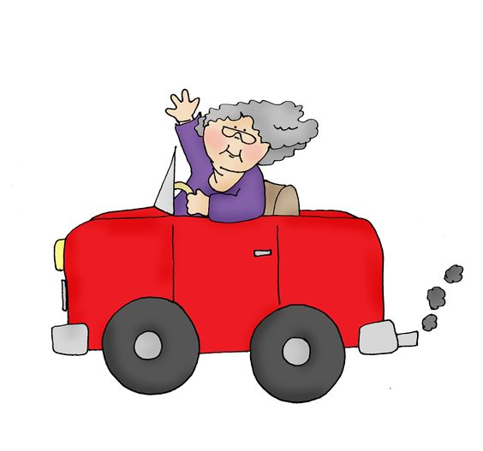
Evaluating universal generalisations
All old people are bad drivers
A single counter example can show it to be false.
Note that this isn’t true for statistical generalisations
“Most old people are bad drivers”

Slide 29
Actual arguments
P1. All old people are bad drivers.
P2. Billy is old.
Therefore,
C. Billy is a bad driver.
Not deductively sound because premise 1 is false!

Slide 30
When should we accept a universal generalization as true?
Long running debate in philosophy of science!
One answer:
We can accept a universal generalization if it follows from an even more general principle (which we have some reason to accept).
”Manslaughter is wrong” true?/false?
”Manslaughter is wrong” follows from “unjustified killings are wrong”
(because all manslaughters are unjustified killings).
And “Unjustified killings are wrong” is true.
Therefore, ”manslaughter is wrong” is true.
Another answer:
We can accept a universal generalization when it’s being true offers the best explanation of the data. (Inference to the best explanation)

Slide 31
Inference to the best explanation
DATA: All ravens I’ve ever seen or heard about have been black.
Candidate Explanation 1: Non-black ravens are really sneaky.
Candidate Explanation 2: It’s a conspiracy! All evidence of non-black ravens has been systematically censored by ...
Candidate Explanation 3: It’s just a coincidence.
Candidate Explanation 4: It’s coded in their DNA... so all ravens are black

Slide 32
Summary
Universal generalization
A claim that says something about all things of a certain kind.
“all” “every”, “anyone”, “everyone”, “whenever”, “never”, “no-one”
How should we translate them in generalised form?
As an “All A are B” statement.
(or, depending on the statement...
All A are not B)
How can we show a universal generalization to be false?
With a single counterexample
How can we show a universal generalization to be true?
When it gives the best explanation of the data.
When it follows from an even more general principle.
Statistical generalization
A claim that says something about some things of a certain kind.
“some”, “many”, “25%”, “a minority”, “most”
Can we show a statistical generalization to be false with a single counterexample?
No!
How can we evaluate statistical generalisations?
More on this in a later lecture!

